Slide 1
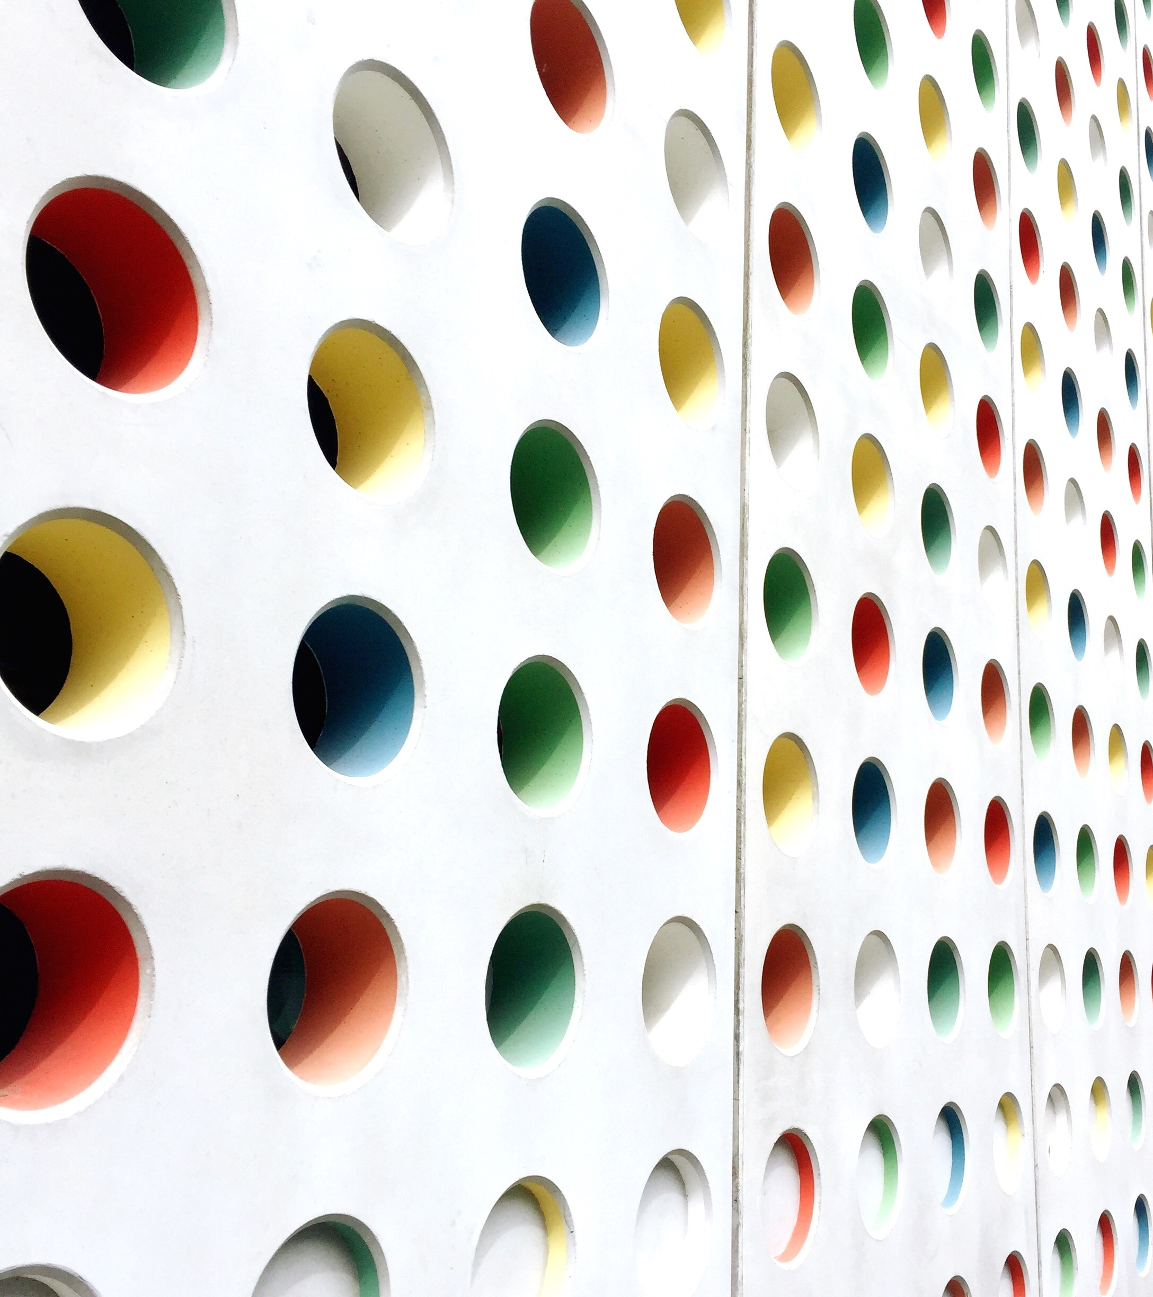
Image Scraping and Classification Project
VIJAY VENKATESH

Slide 2
Problem Statement
Images are one of the major sources of data in the field of data science and AI. This field is making appropriate use of information that can be gathered through images by examining its features and details.

Slide 3
Business Goal
To build a deep learning-based Image Classification model on images that will be scraped from e-commerce portal.

Slide 4
Steps
Extracting data from websites
Loading data set
Model building
Performing prediction
Saving best model

Slide 5
Data extraction (phase 1)
900 images from each categories from e-commerce portal, Amazon.com. The clothing categories used for scraping are:
- Sarees (women)
- Trousers (men)
- Jeans (men)

Slide 6
Model building (phase 2)
After the data collection and preparation is done, building an image classification model that will classify between these 3 categories mentioned above.
Loading data
Training model
Saving model
Performing prediction on random data

Slide 7
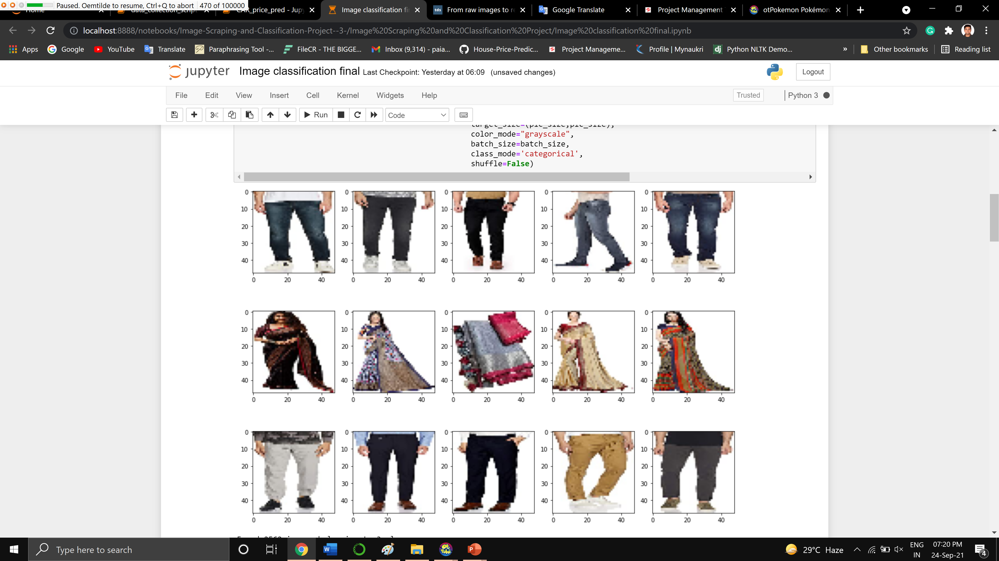
Random images from the dataset

Slide 8
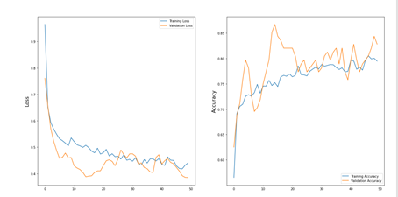
Loss and Accuracy on the train and validation sets

Slide 9
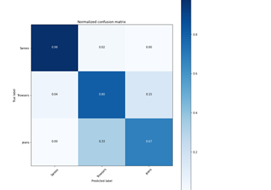
Confusion matrix of our predictions

Slide 10
Model and Accuracy
The CNN model gives an accuracy 0.8043478260869565

Slide 11
Conclusion and Observation
The model has a great performance for 80% accuracy but as per observation under random images there was a point were model confuses between to Jeans and Trousers as the input images had some similar features which was considerably difficult to distinguish between to classes. This problem can be solved with minor tweaks and using a large dataset to train the model

